Slide 1
Software Defined Radio Receiver using ADALM-Pluto
Presented by: [Group 3 – I]
  Nagasushma Karnati
  Sneha Potadar
  Alireza Asgari
  Manzoor Ambekar
  Saptarshi Chakravorty
Department of Information and
Electrical Engineering

Slide 2
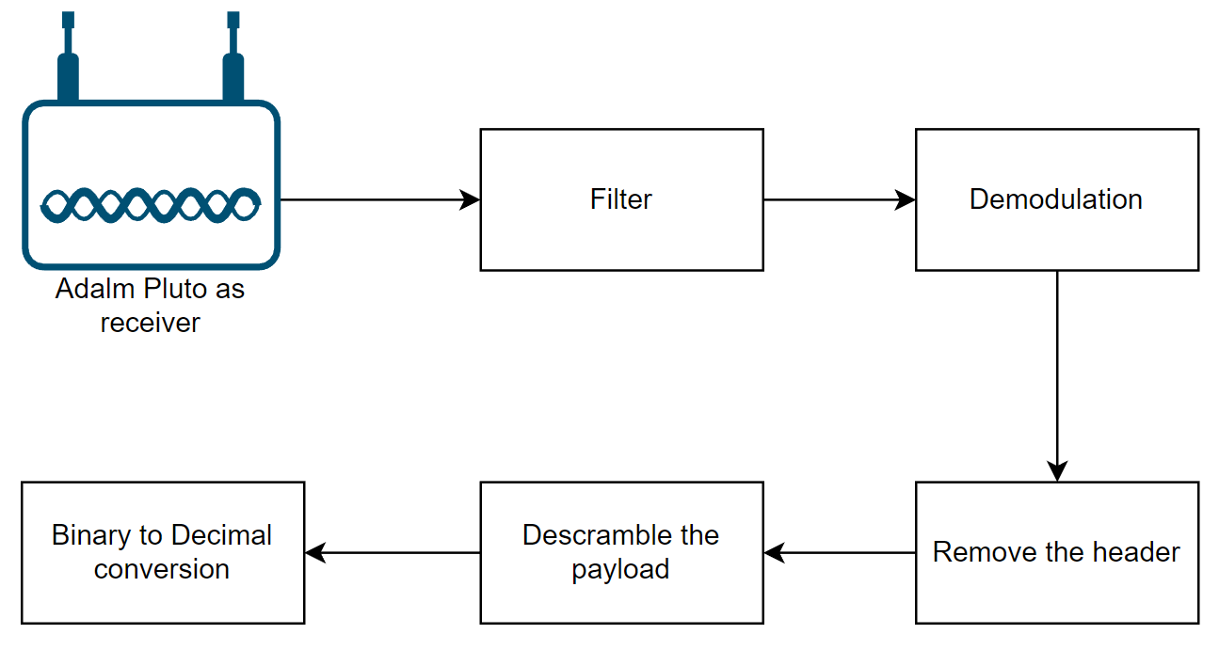
Block Diagram

Slide 3
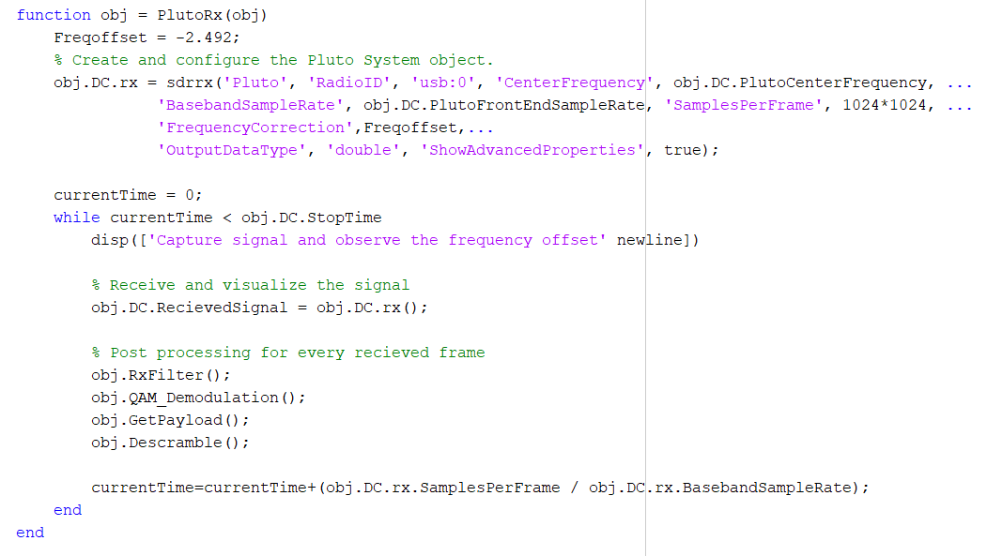
Adalm Pluto as a receiver

Slide 4
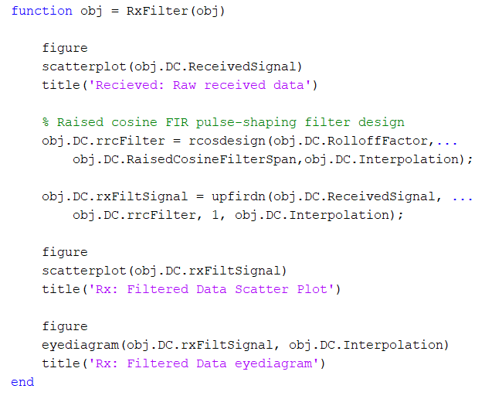
Filter

Slide 5
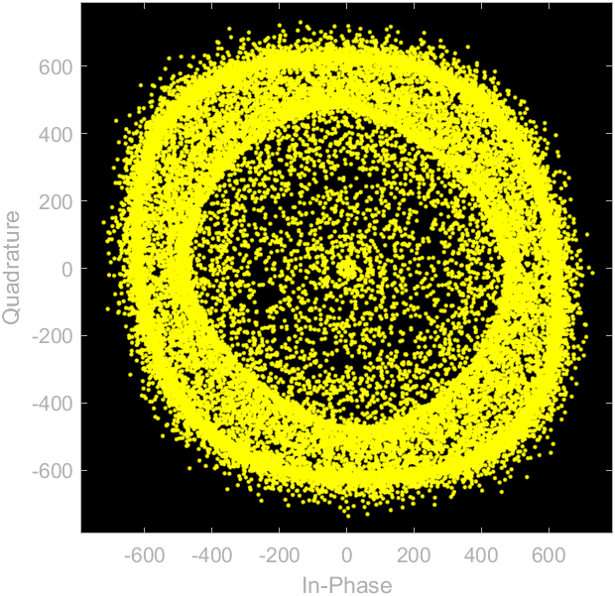
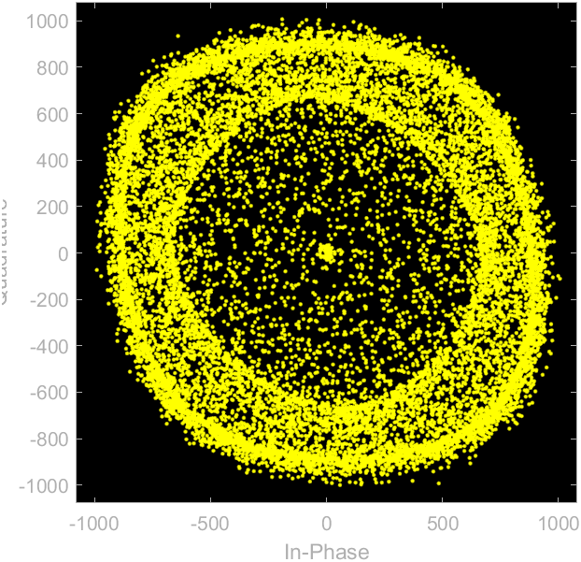
Filter
For the received data via Adalm Pluto:
Scatter plot for the raw received data
Scatter plot after receiver filtering
Due to the frequency offset miscalculation, we have observed the moving constellation diagram for received data.
To verify the receiver signal processing, locally generated data is processed, and represented in the next slide

Slide 6
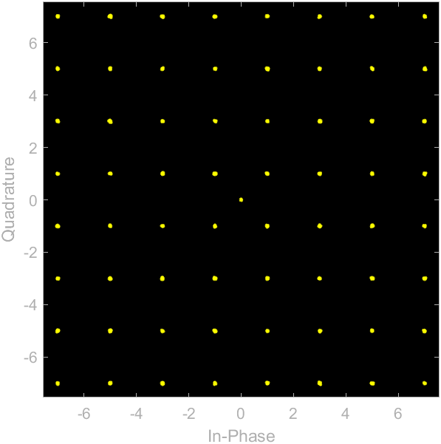
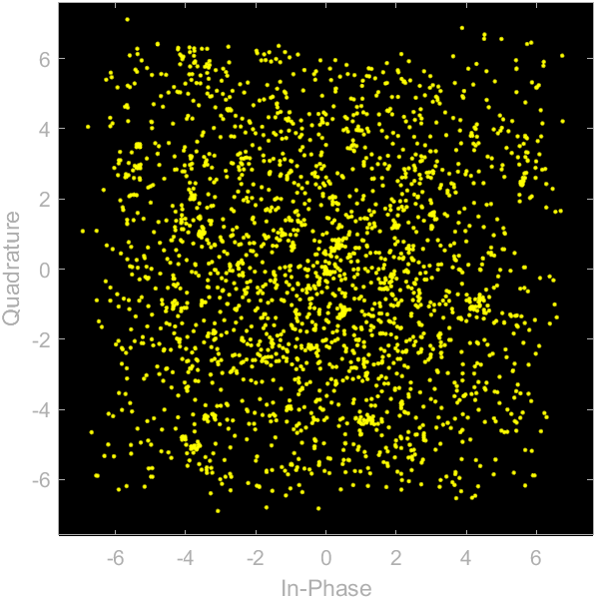
Filter
For the ideal data transmission with software:
Scatter plot for the raw received data
Scatter plot after receiver filtering

Slide 7
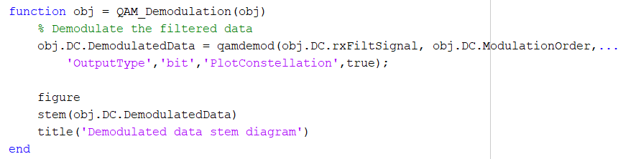
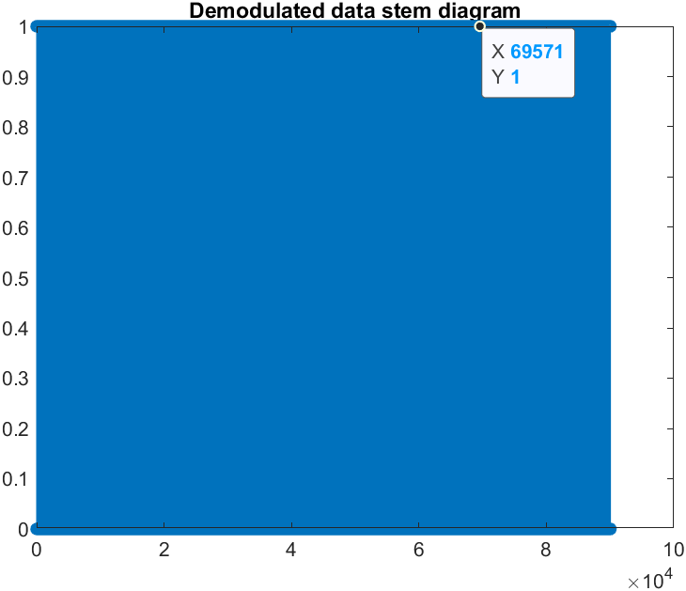
QAM Demodulation

Slide 8
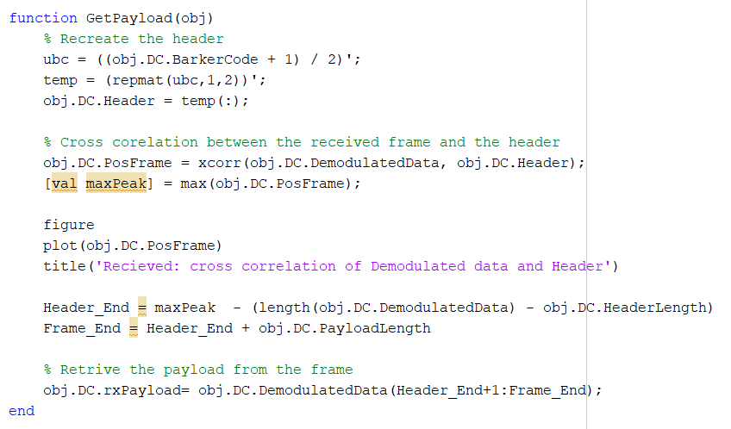
Retrieve the payload

Slide 9
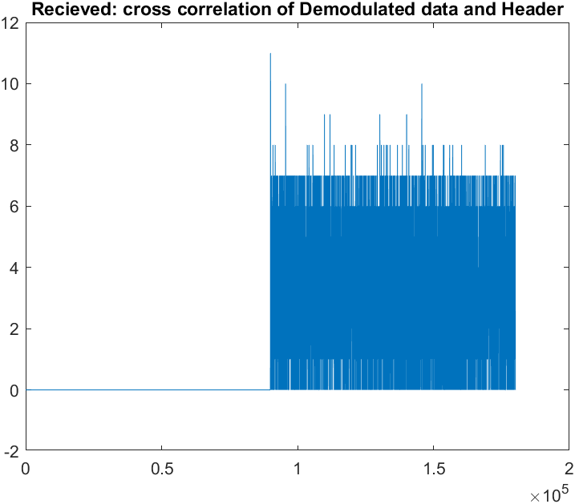
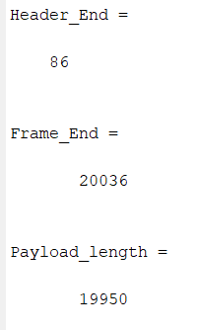
Retrieve the payload

Slide 10
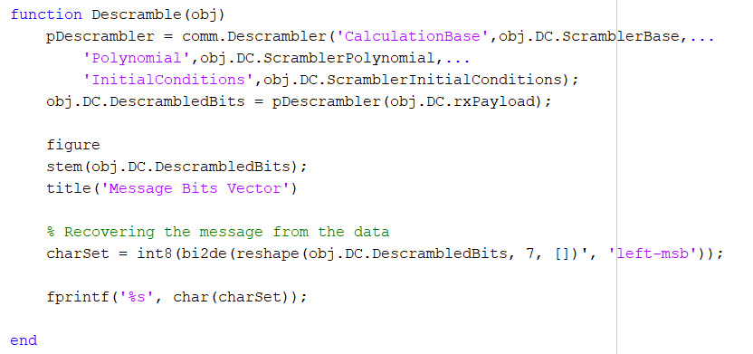
Descramble and decode the payload
As we didn’t had proper frequency offset calculation. The received data via Adalm Pluto is incorrect.

Slide 11
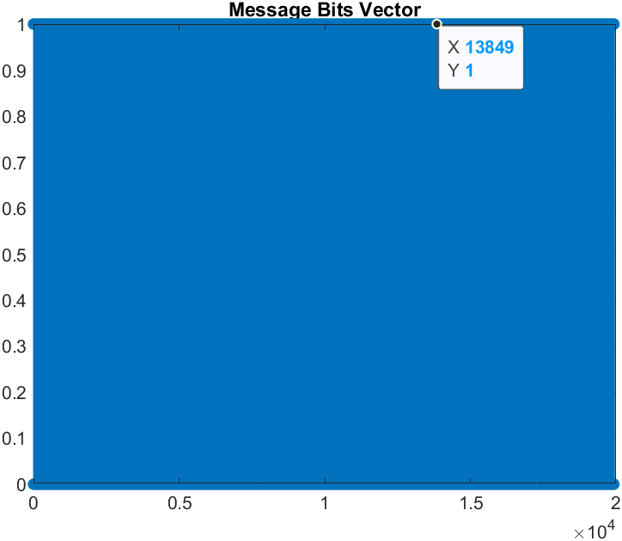
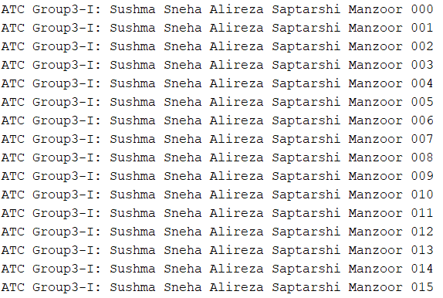
Descramble and decode the payload
After processing the locally generated data, the original message was successfully received and decoded.

Slide 12
Thank you for your attention!
Any Questions?

